Slide 1
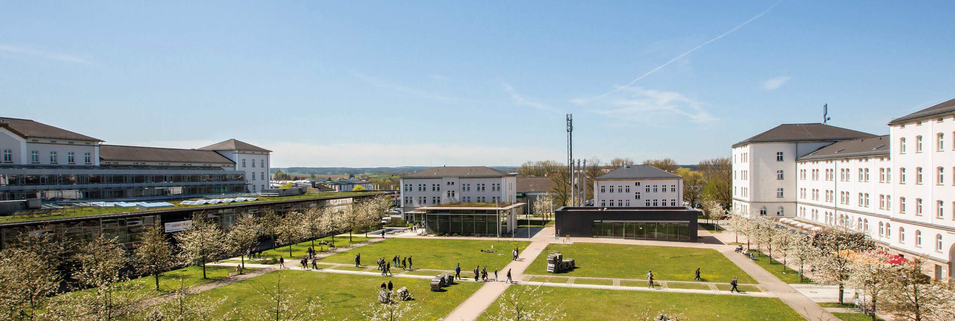
Project Work programming starter
Summer Semester 2024
Author: Nitesh Morem, Kashif Riyaz
Under the guidence of Prof. Dr.-Ing. Christian Bergler, Prof. Dr. Sandra Rebholz | OTH Amberg-Weiden

Slide 2
Content
01
Task 1
02
Task 2

Slide 3
a) & b)
A) Files read:
female_coaches.csv
male_coaches.csv
female_players.csv
male_players.csv
female_teams.csv
male_teams.csv
B) columns in each file:
Players: 109 columns
Teams: 54 columns
Coaches: 8 columns

Slide 4
c)
New column added: ‘Sex`.
Combined DataFrames shapes:
Players: (185056, 110)
Teams: (7178, 55)
Coaches: (1463, 9)
Note: we have used 0 to represent the female players,teams and coaches and 1 to represent male players,teams and coaches

Slide 5
d)
The shape of the df_player DataFrame is (185056,28).
The shape of the df_team DataFrame is (7178,19).
The shape of the df_coach DataFrame is (1463, 5) .
Note: we have included Sex column as well in all the Dataframes.

Slide 6
e)
we divided this task into three subtasks.
Work on df_coach.
Work on df_team.
Work on df_players.

Slide 7
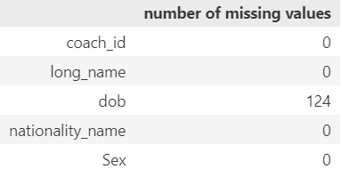
1. Working on df_coach.
124 missing values in `dob` column.
Steps taken:
- Converted `dob` values using `pd.to_datetime()`
- Calculated mean of `dob` column.
- Replaced missing values with mean.

Slide 8
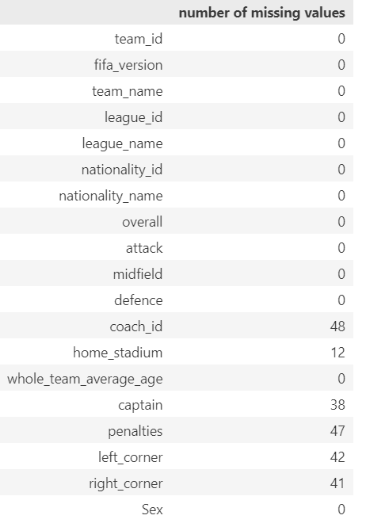
2. Working on df_team.
Handling Missing Values:
Grouped by `team_name`.
Applied backward fill.

Slide 9
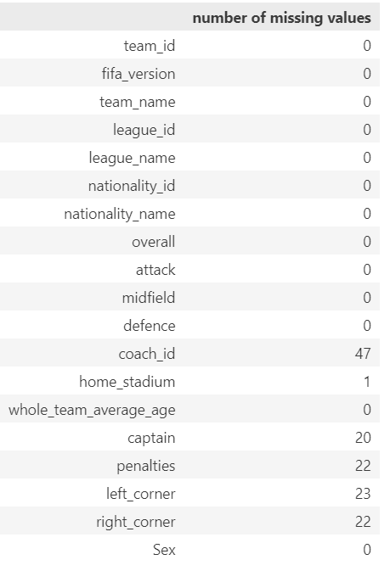
Cont…….
But some of the values were not available in previous versions of FIFA.
So, we assigned random values to these missing values.
Those random values are:
coach_id=12345678.0
home_stadium='OTH Amberg Stadium'
Captain=123456.0
penalties=654321.0
left_corner=642135.0
right_corner=531246.0

Slide 10
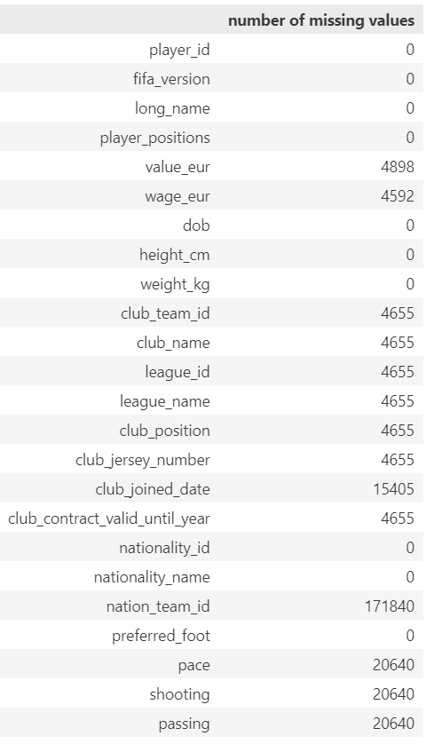
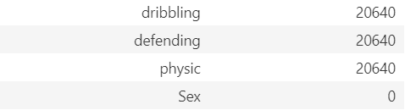
3. Working on df_players.
Handling Missing Values:
Initial attempts:
Applied backward fill for `value_eur` and `wage_eur`.
Final steps:
Used mean values for remaining missing data.

Slide 11
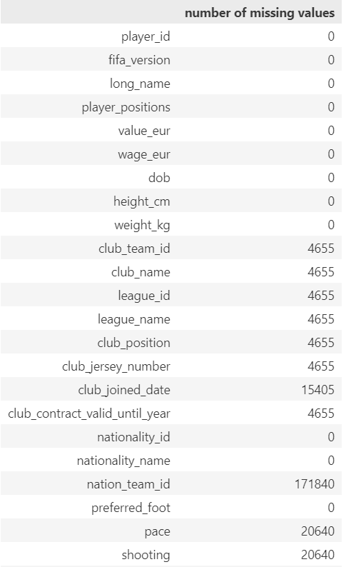
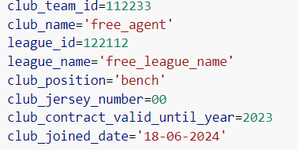
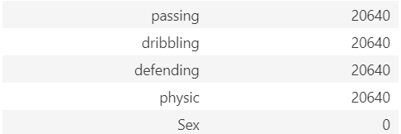
Cont…..
Filling Missing Club Data:
Backward fill for various columns
Identified `Free_agents` for players without club data
Replaced missing data with custom valuesData used for free agents.
Custom Data used:

Slide 12
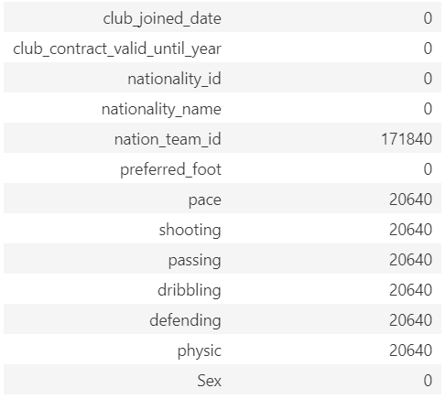
Cont…
Missing `club_joined_date` replaced with `20-01-2024`
Assigned random `nation_team_id` for missing values: 000000

Slide 13
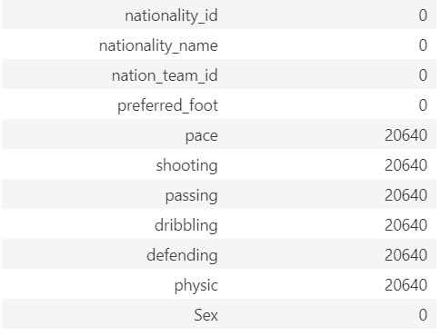
Cont….
Applied backward fill.
Used mean values for new players.

Slide 14
Task 2

Slide 15
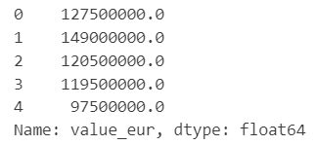
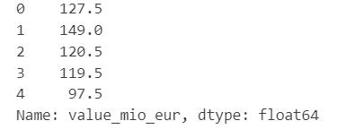
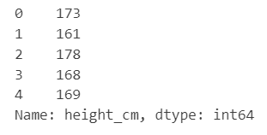
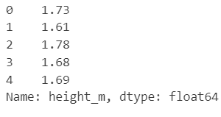
a)
The column value_eur was converted into value_mio_eur in df_players data frame.
Height_cm column was also converted into height_m column.
Before
After
Before
After

Slide 16
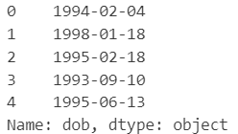
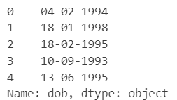
Cont….
Similarly, the dob column was also converted form YYYY-MM-DD to DD-MM-YYYY.
Before
After

Slide 17
b)
Total number of unique players that are involved in the game are 55328.
The youngest player is Alexandru Irimia with DOB of 2006-12-05.

Slide 18
c)
The smallest player in height is Kiki Pickett with the height of 1.49m.
The tallest player in height is Kristof Van Hout with the height of 2.08m.
The thinnest players based on weight are Elena Julve Pérez, Koko Ange N'Guessan, Claudia Roldán Blanco, 三浦 成美, 许燕露 with the weight of 45kg.
The thickest players based on weight are Saheed Adebayo Akinfenwa, Costel Fane Pantilimon, Kristof Van Hout, Tim Wiese with the weight of 110kg.

Slide 19
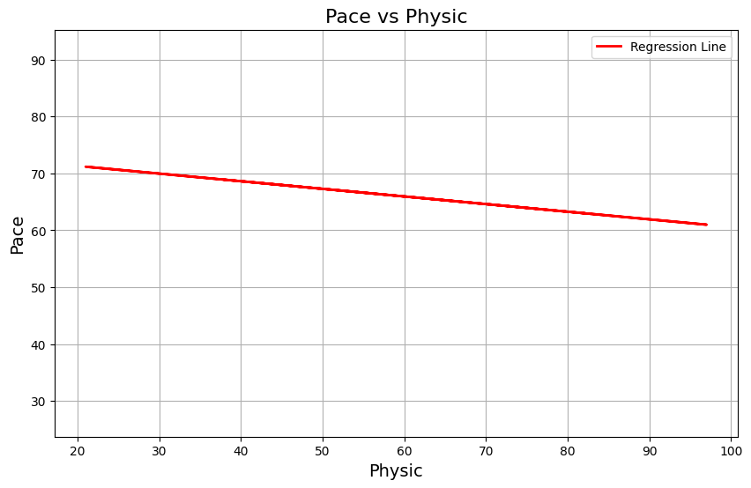
Cont….
As the physic increases the pace decreases.

Slide 20
d)
Highest Wage: Lionel Andrés Messi Cuccittini, 575.0 thousand euros/week.
Highest Wage in EA Sports FC 24: Kevin De Bruyne, 350.0 thousand euros/week.
Note

Slide 21
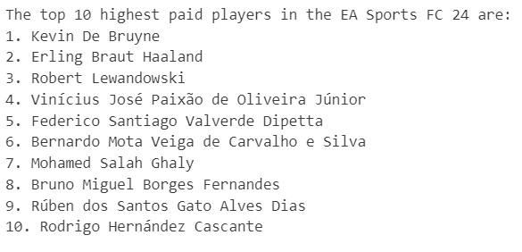
Cont…..

Slide 22
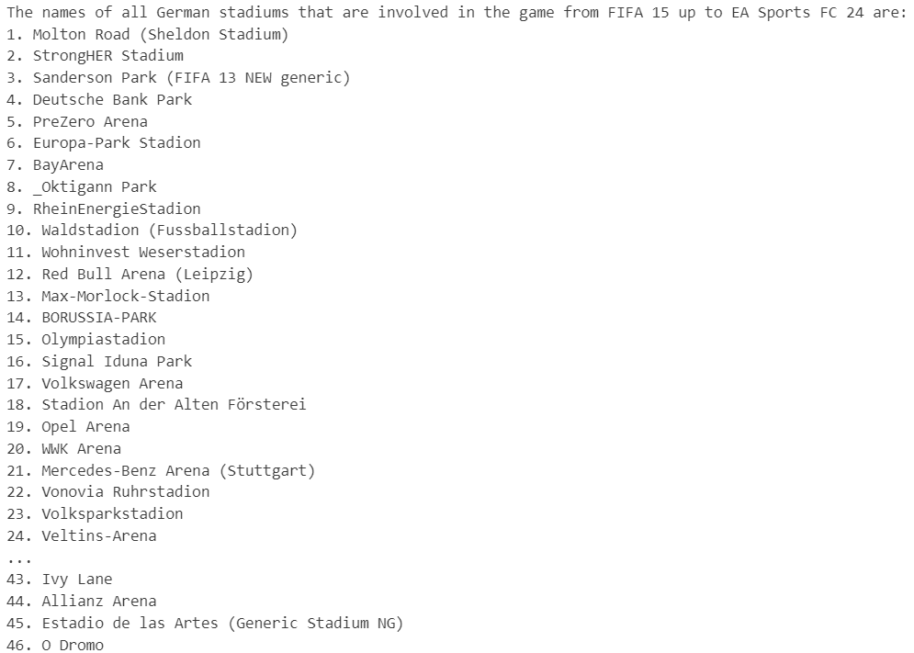
e)

Slide 23
f)
Oldest Active Coach: Mircea Lucescu
DOB: 1945-07-29

Slide 24
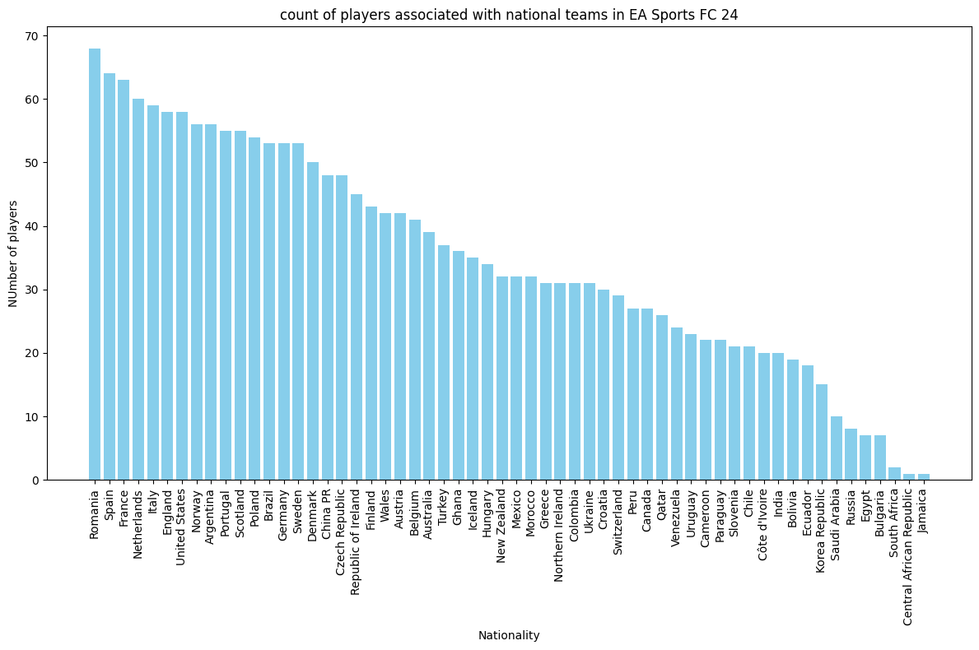
g)

Slide 25
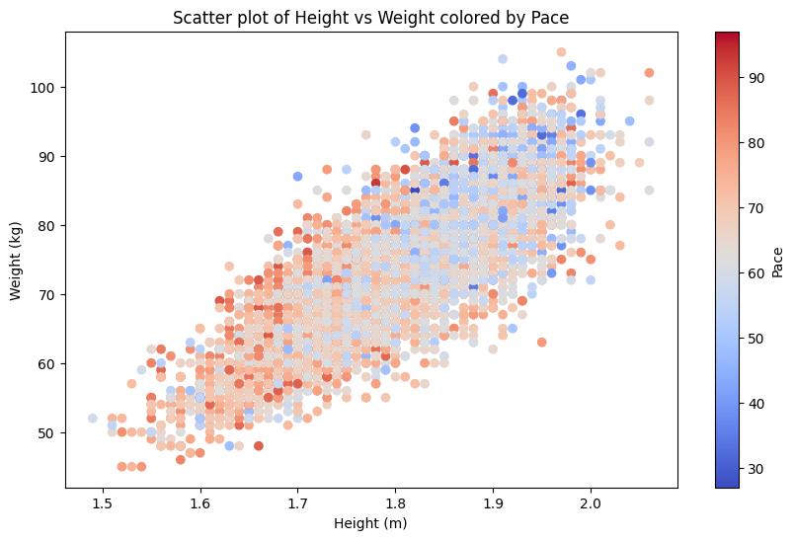
h)

Slide 26
i)
Skills Analysis:
Best Female Player:
Alexia Putellas Segura, average skill 84.
Best Male Player:
Federico Santiago Valverde Dipetta, average skill 83.
The players who have the best measured average skill across all versions are Alexia Putellas Segura, Lucia Roberta Tough Bronze.
Note: As we all know Cristiano Ronaldo is the best player in the world but in this case the average skills are based on defending, passing, physic, shooting, dribbling, pace.

Slide 27
Cont……
The top 10 players with highest skills are:
1. Alexia Putellas Segura.
2. Lucia Roberta Tough Bronze.
3. Alexia Putellas Segura.
4. Federico Santiago Valverde Dipetta.
5. Leon Christoph Goretzka.
6. Fridolina Rolfö.
7. Amel Majri.
8. Carli Anne Hollins.
9. Carli Anne Hollins.
10. Carli Anne Hollins.
^Note: some of the names are repeated means the player has different average skills in another version of the game and still makes it to top 10.

Slide 28
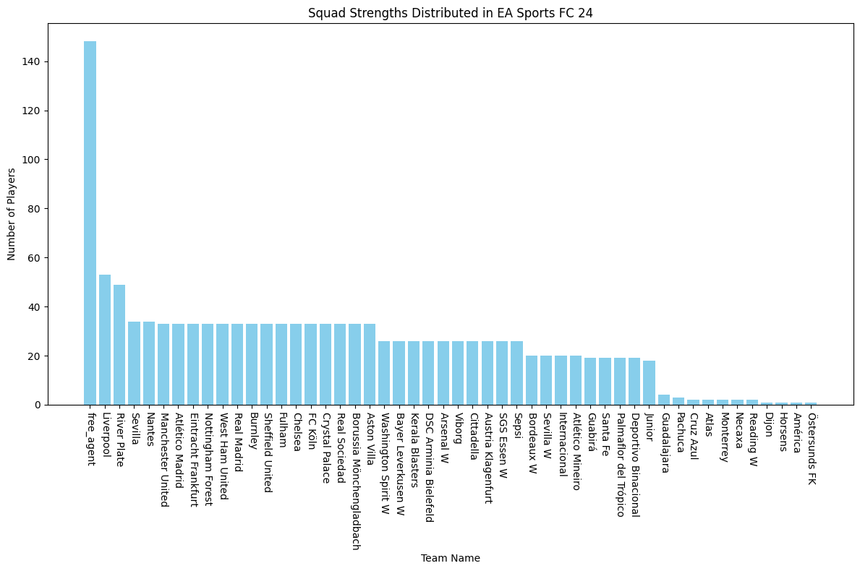
j)
Note: free_agents were set in task 1 these are those players which do not have any club.

Slide 29
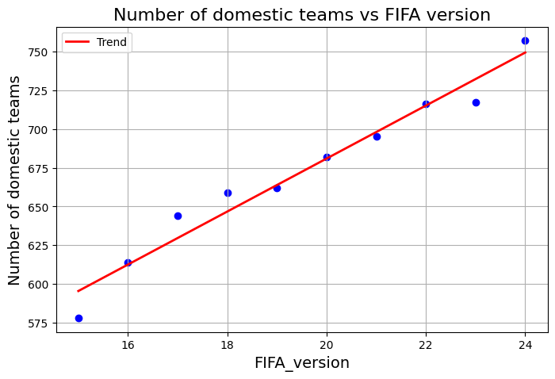
k)
The number of teams are increased in each version of the FIFA.

Slide 30
l)
Task Breakdown:
National Teams Distribution:
Visualize national teams and associated teams per year.
Coaches' Nationality Trends:
Identify and visualize the nationality of coaches from different leagues.
Temporal and Demographic Trends:
Analyze trends in the number of coaches and teams per nation over the years.

Slide 31
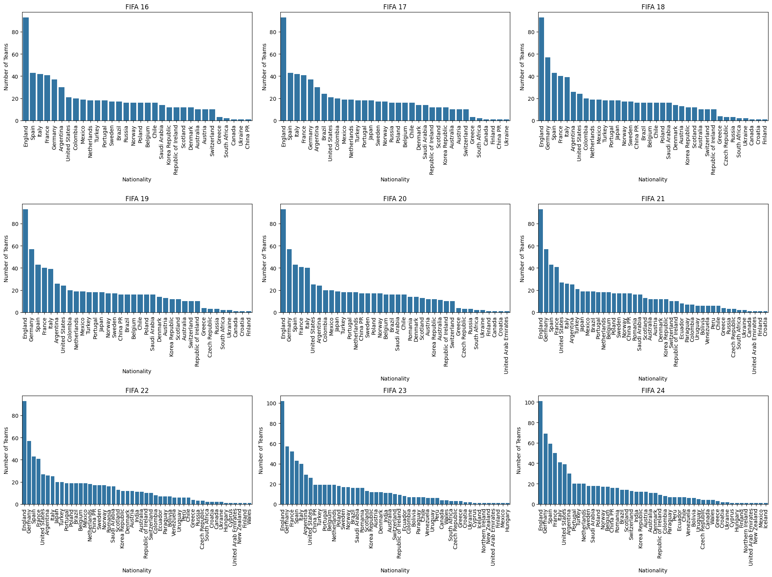
l) Number of teams vs nationality

Slide 32
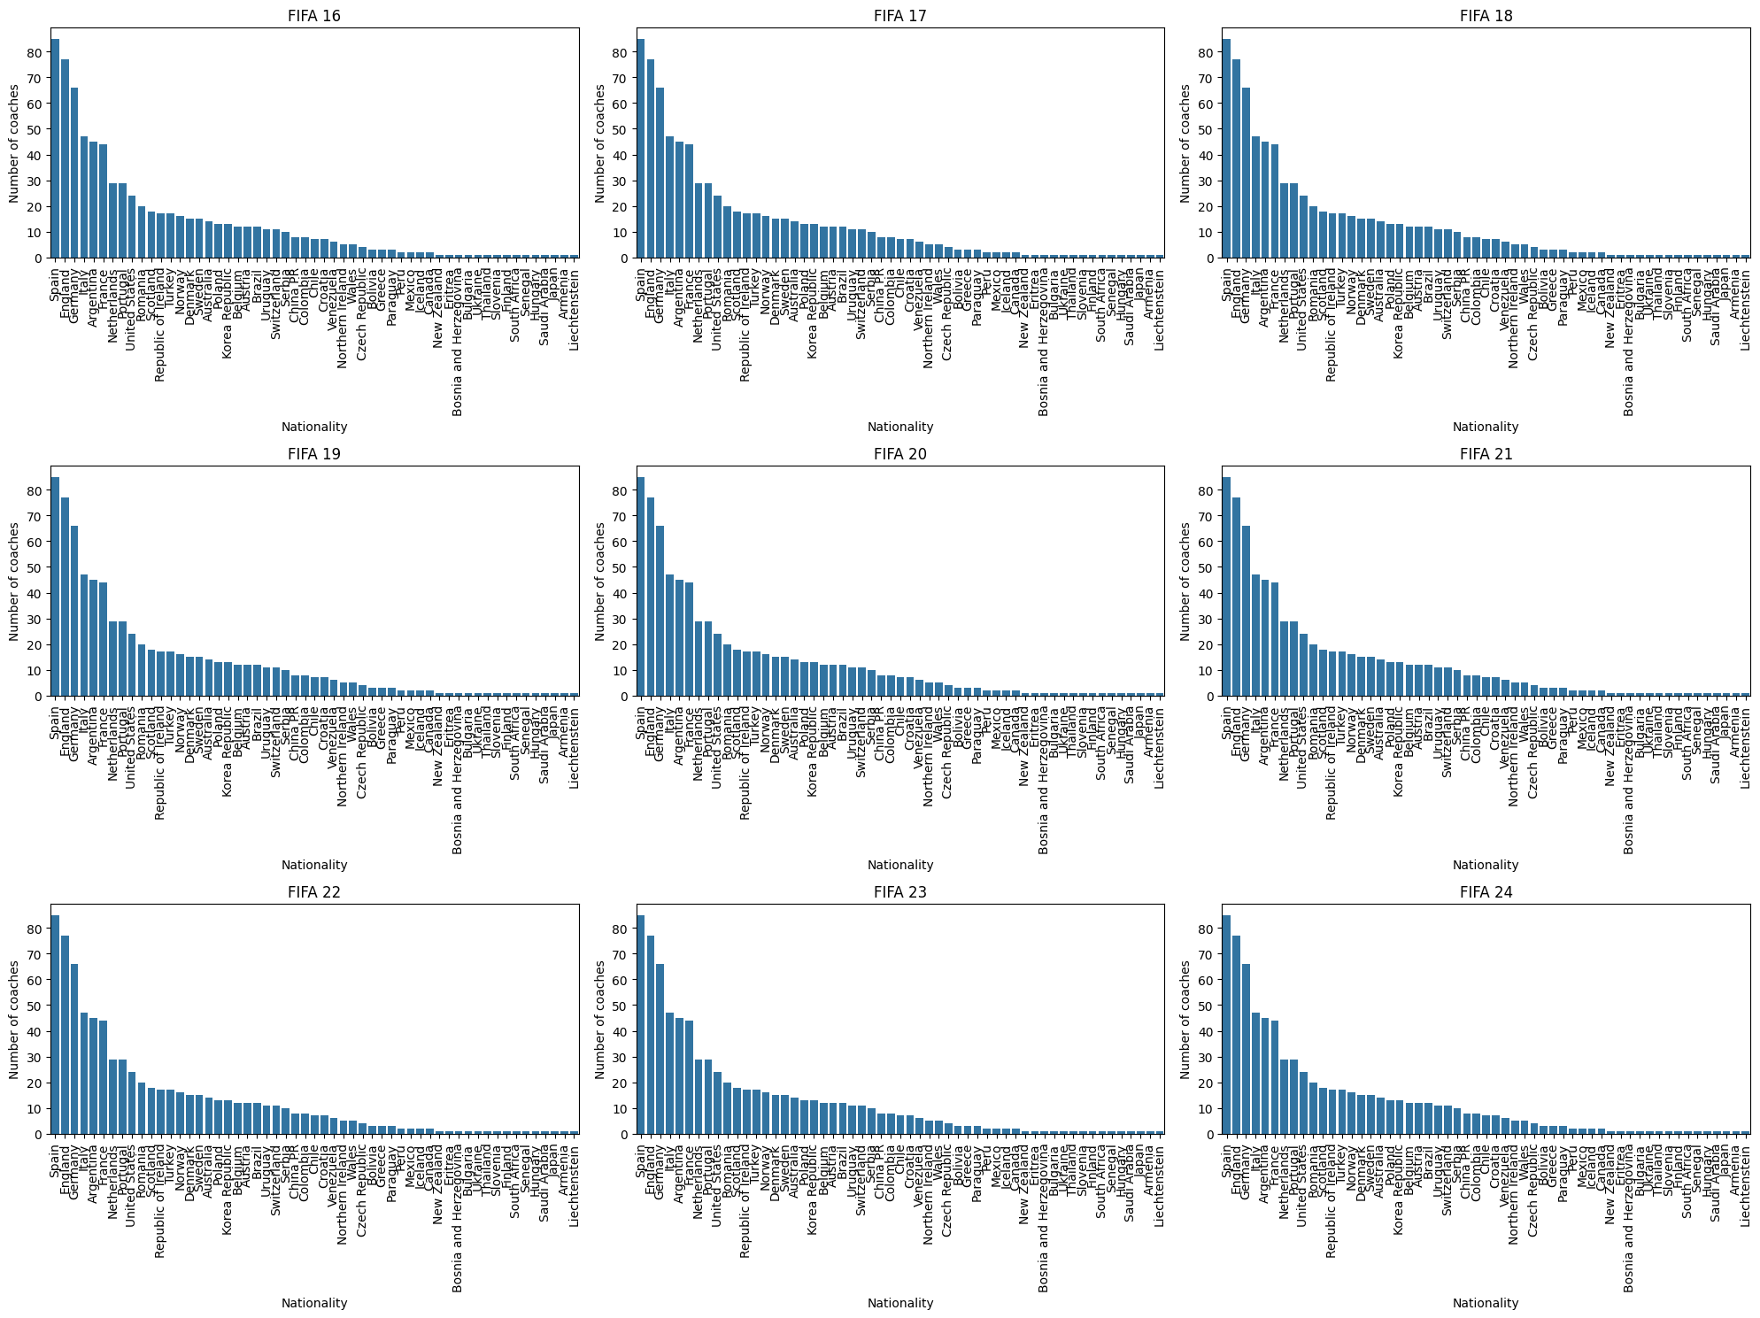
b) Number of coaches vs nationality

Slide 33
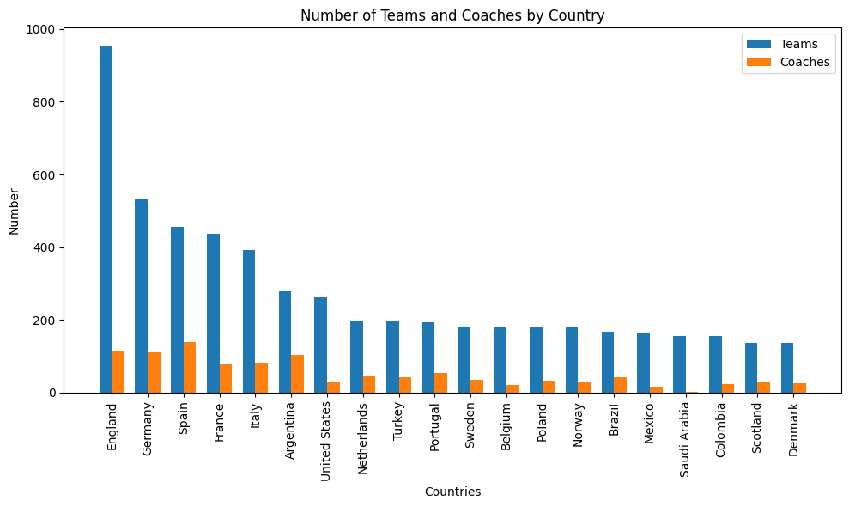
c)
Note: Here we have only shown top 20 nations.

Slide 34
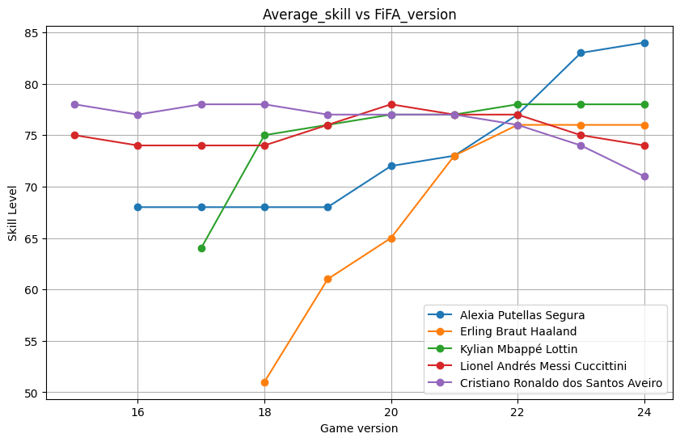
m)

Slide 35
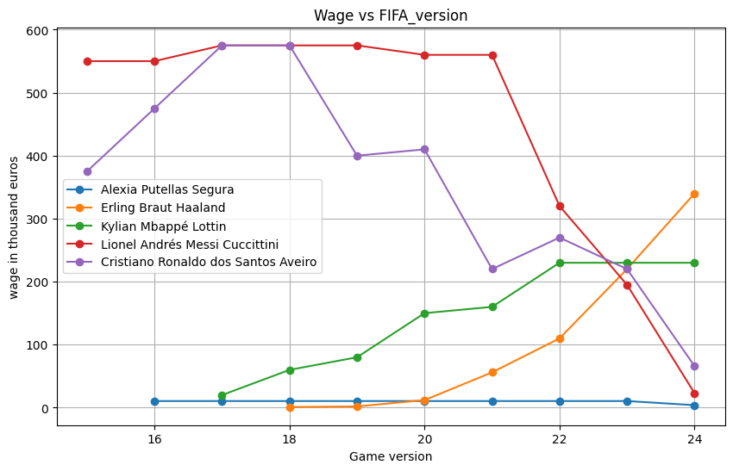
Cont………

Slide 36
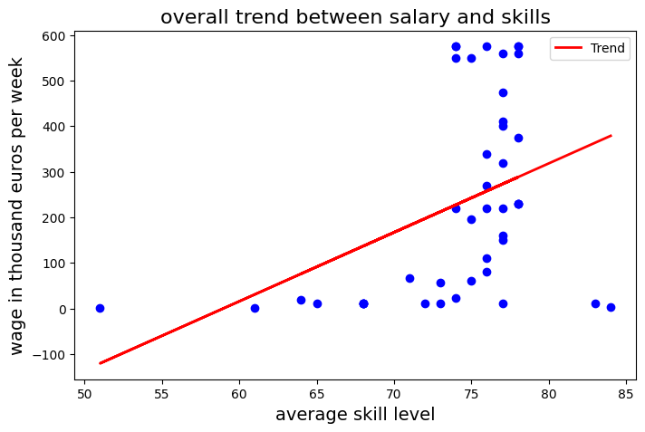
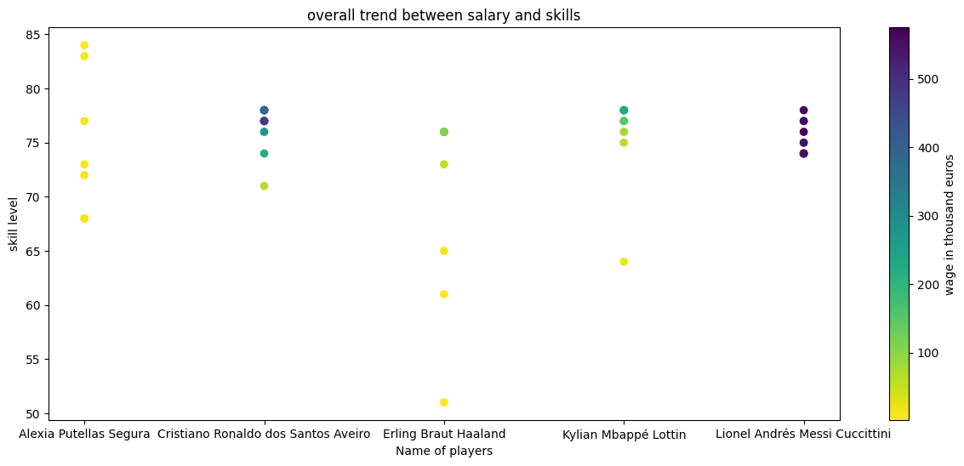
Cont….
Note: This trend is based on the fallowing players:Alexia Putellas , Erling Haaland , Kilian Mbappe , Lionel Messi , Christiano Ronaldo .

Slide 37
Q/A

Slide 38
Vielen Dank!
Ostbayerische Technische Hochschule (OTH) Amberg-Weiden Kaiser-Wilhelm-Ring 23 | 92224 Amberg

